Slide 1
What are we learning from language?
Distributional semantics reflect social stereotypes
Molly Lewis
Department of Psychology/
Social and Decision Sciences
14 February 2020

Slide 2
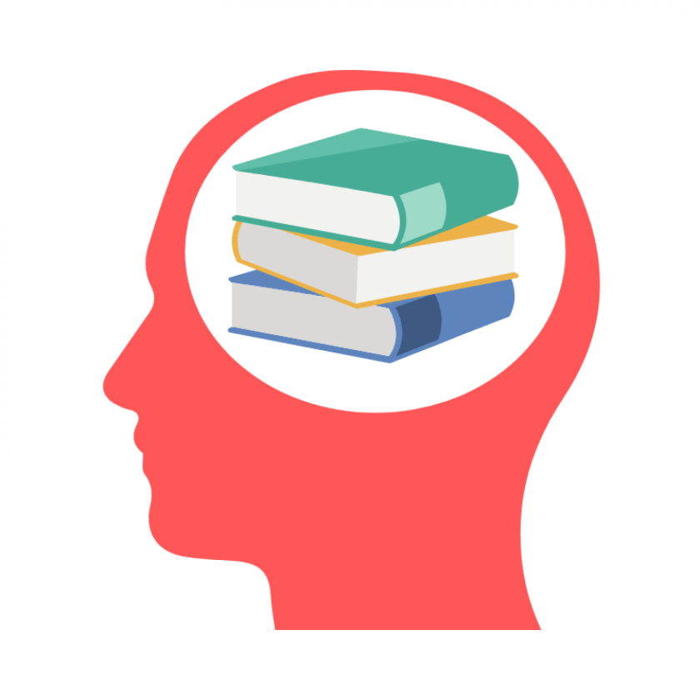
Over the lifespan, humans acquire a lot of knowledge about the world
Some of that comes from language:
The earth is round.
Mongolia is really cold.
Octopi have three hearts.
You should respect older people.
What about more implicit messages in language?

Slide 3
Word co-occurrences as related to word meaning
Distributional semantics: Semantic similarity between two words A and B is a function of the similarity of the linguistic contexts in which they appear.
.
.
.
Sam ate the red apple near the red barn...
 | Sam | ate | the | red | apple | near | barn
Sam | 0 | 1 | 0 | 0 | 0 | 0 | 0
ate | 1 | 0 | 1 | 0 | 0 | 0 | 0
the | 0 | 1 | 0 | 2 | 0 | 1 | 0
red | 0 | 0 | 2 | 0 | 1 | 0 | 1
apple | 0 | 0 | 0 | 1 | 0 | 1 | 0
near | 0 | 0 | 1 | 0 | 1 | 0 | 0
barn | 0 | 0 | 0 | 1 | 0 | 0 | 0
.
.
.
Notes:
If you track word co-occurrences across a large corpora of text,
Given this corpus of text, we need some way to derive the meanings of words from them.
To do that, we’re going to assume a model of semantics called distributional semantics:
Semantic similarity…
To illustrate this approach, consider this toy corpus that contains only a single sentence.
If we wanted to derive the semantics of these words from this sentence alone we could construct a matrix where we asign each unique word to a row and column, and track the occcurences DIRECTLY NEXT TO EACHOTHER between words.
For example beause sam co-ocurs with ate, we would record that count in the appropriate cell.
This approach would tell us that barn and apple are more similar than barn and Sam, because barn and apple appear in similair context (both after the word red).
.

Slide 4
Do distributional semantics reflect gender stereotypes?
Men - career
Women - family
Male
Career
Career
Female
Family
Female
Family
Notes:
Explicit (Nosek et al., 2002): d = .5
Implicit: d = .72
Characteristic of human cognition
Prevalent
For exmaple
Well studied and concsequenctial social bias
How strongly do you associate the following with males and females career vs. family

Slide 5
Implicit Association Test (IAT)
Attributes
A = {career, salary, office, business, professional}
B = {family, home, parents, children, cousins}
Categories
X = {man, male, he, him, boy}
Y = {woman, female, she, her, girl}
man
career
woman
family
man
career
woman
family
compare reaction time
Participants slower for incongruent mapping (right), suggesting bias to associate men with career.
Notes:
* https://implicit.harvard.edu/implicit/takeatest.html
Task is nice because it measures implicit association, and so it resists people’s self-presentation strategies (prefer not to express)
* Can do this for lots of different associations

Slide 6
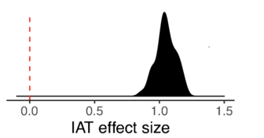
Implicit gender bias by country
N = 764,520 participants
(Project Implicit:
Nosek, Banaji, & Greenwald, 2002)
https://implicit.harvard.edu/implicit/

Slide 7
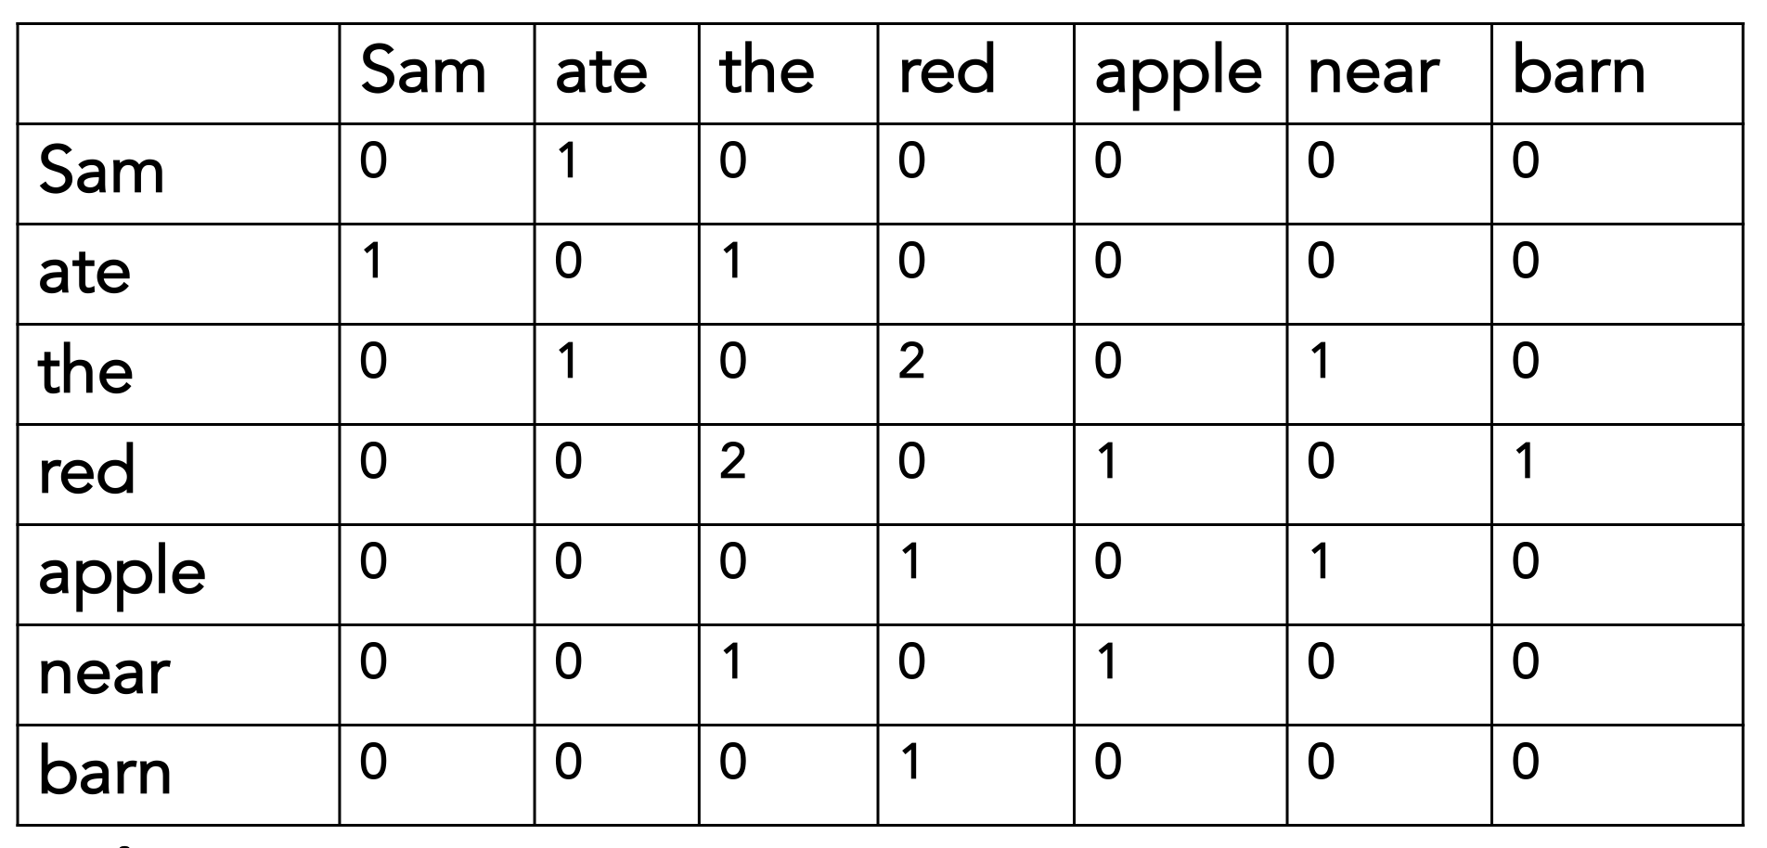
Does bias in language predict bias in IAT?
Language measure (word-occurrences)
Psychological measure (IAT)
Word embedding models trained on
25 languages

Slide 8
Implicit Association Test (IAT)
…based on word co-occurrences
Attributes
A = {career, salary, office, business, professional}
B = {family, home, parents, children, cousins}
Categories
X = {man, male, he, him, boy}
Y = {woman, female, she, her, girl}
man
career
woman
family
man
career
woman
family
compare reaction time
compare distance
in semantic space
Notes:
* https://implicit.harvard.edu/implicit/takeatest.html
Task is nice because it measures implicit association, and so it resists people’s self-presentation strategies (prefer not to express)
* Can do this for lots of different associations

Slide 9
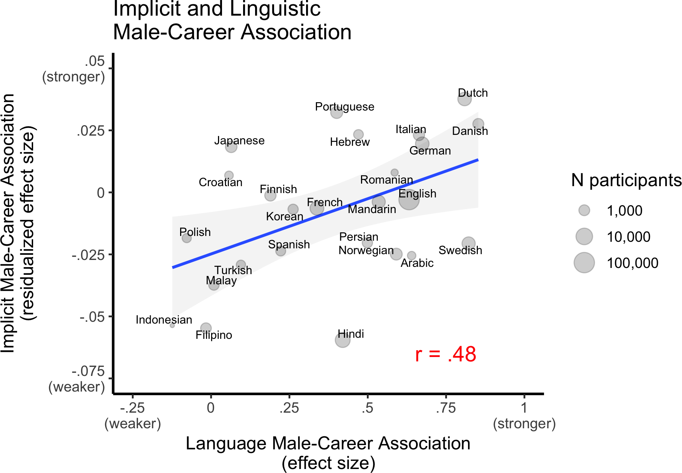
(Lewis & Lupyan, under revision, NHB)
Notes:
In indeed language is playing a causal role, ….
Languages with stronger career-gender association have speakers with stronger career-gender association.

Slide 10
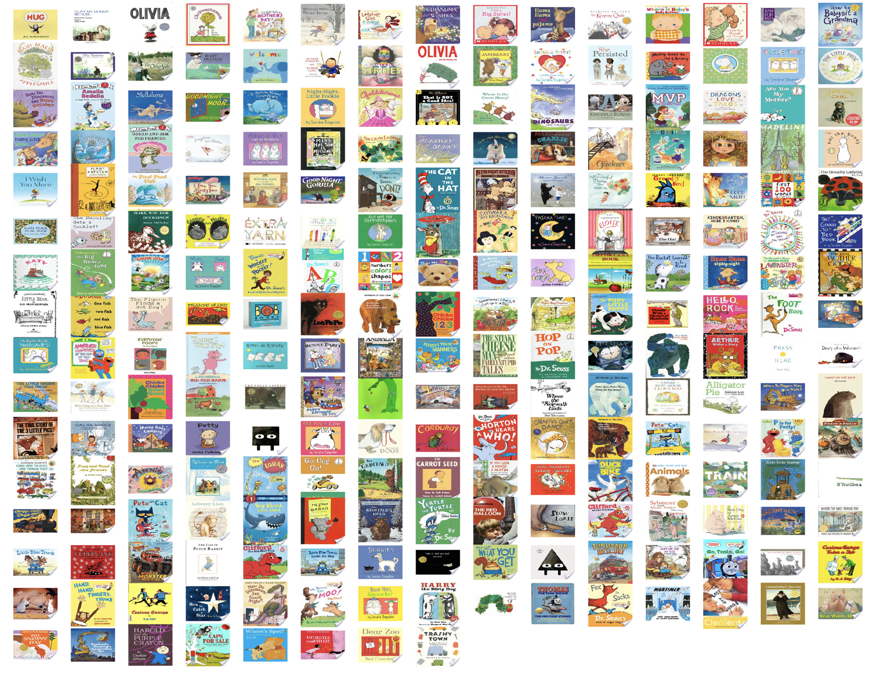
249 popular children’s picture books, aimed at children 0-5 years
Trained word embedding model on this corpus
Notes:
And, finally, this framework that I’ve been using to explain LANGUAGE STRUCRURESA– the notion of multiple timescales – as a more general framework that can be applied to domains beyond language.
For example, recently I’ve become interested in using this framework to think about the origins of a dfiferent socials tructure - gender biases
-> in paraticular – the role that language might play in the emergence of these biases.
Take – for example – the fact that most doctors tend to be men
This is a fact that is likely the product of processes at shorter timescale.
You might imagine that we are just more likely to talk about men as being doctors (perhaps because it reflects the reality of the world), and in aggregate that leads to language statistics that are biased to associate men with doctors, relative to women
At the developmental timescale, you might imagine that kids are exposed to the biases perhaps in an exaggerated away; and that they could particularly sensitive to the statistics
And, over time, processes at these two shorter timescales contribute to biases at the population level.

Slide 11
(Lewis, Cooper-Borkenhagen, Lupyan & Seidenberg, in prep.)

Slide 12
What are we learning from language?
Distributional statistics in language reflect social stereotypes.
Magnitude of linguistic biases correlated with behavioral measure of bias (IAT).
Biases present – and larger – in literary input to children.
Evidence is correlational: More work is needed to establish causality.

Slide 13

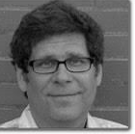
Thanks!
Matt Cooper-Borkenhagen
(U. of Wisconsin-Madison)
Gary Lupyan
(U. of Wisconsin-Madison)
Mark Seidenberg
(U. of Wisconsin-Madison)
Children’s book gender app:
https://mlewis.shinyapps.io/SI_KIDBOOK

Slide 14
+
Measuring word associations in distributional statistics
Word embedding model on corpus of movie and TV subtitles in English (Lison & Tiedemann, 2016; Van Paridon & Thompson, in prep.).
Association as cosine distance in semantic space.
”home”
+
+
woman
+
sister
+
+
girl
she
+
her
hers
+
+
daughter
female
him
+
+
his
+
man
+
+
boy
he
+
+
brother
son
male
Notes:
movies and TV shows; cor is .63

